Slide 1
Lập trình ứng dụng mobile (Spring 2020)
Session 3: Building
Instructor: Nguyen Tri Nhan

Slide 2
Starting an App
Starting a new Ionic app is incredibly simple. From the command line, run the:
ionic start command and the CLI will handle the rest.
ionic start Every great app needs a name! 😍 Please enter the full name of your app. You can change this at any time. To bypass this prompt next time, supply name, the first argument to ionic start. ? Project name: █
The Ionic CLI will display prompts asking for the new project's name and which template to use. These details can be provided as command arguments:
ionic start myApp tabs

Slide 3
Here, myApp is the name of the project, tabs is the starter template, and the project type is angular.
tabs is not the only project template available. Between all project types, there are three templates available:
tabs: A tabs based layout
sidemenu: A sidemenu based layout
blank: An empty project with a single page
See all available templates with the following command:
ionic start –list
These templates provide a great starting point for any app and include all the best practices for making a code base scale.

Slide 4
Scaffolding out an App
Contents
Project Structure
Generating New Features
Once an app is created by the Ionic CLI, the next step is to start building out features and components. The majority of the app will be developed in the src/app/ directory.

Slide 5
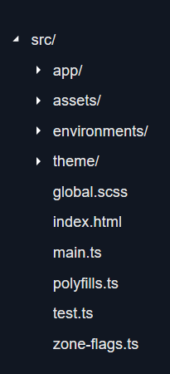
Project Structure
The src/ directory has items such as the index.html file, configuration files for tests, an asset folder for images, and the main app/ directory for the app's code.

Slide 6
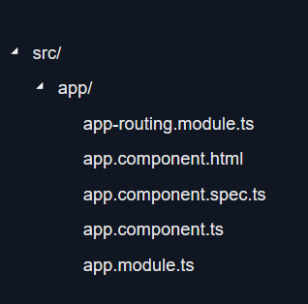
The src/app/ directory contains the root app component and module as well as additional directories that contain app features such as pages, components, services, etc.

Slide 7
Generating New Features
The Ionic CLI can generate new app features with the ionic generate command. By running ionic generate in the command line, a selection prompt is displayed which lists the available features that can be generated.
ionic generate
? What would you like to generate?
❯ page
component
service
module
class
directive
guard
After a selection is made, the Ionic CLI will prompt for a name. The name can be a path, allowing easy generation of features within an organized project structure.

Slide 8
Any level of nesting is allowed, such as portfolio/intro. You can easily scope components to pages by using ionic g component "portfolio/intro/About Me", for example.
ionic generate
? What would you like to generate? page
? Name/path of page: portfolio █`
Alternatively, the type and name of the generated feature can be entered on the command line:

Slide 9
ionic g page "User Detail"
> ng generate page "User Detail"
CREATE src/app/user-detail/user-detail.module.ts (564 bytes)
CREATE src/app/user-detail/user-detail.page.scss (0 bytes)
CREATE src/app/user-detail/user-detail.page.html (138 bytes)
CREATE src/app/user-detail/user-detail.page.spec.ts (720 bytes)
CREATE src/app/user-detail/user-detail.page.ts (280 bytes)
UPDATE src/app/app-routing.module.ts (475 bytes)
[OK] Generated page!

Slide 10
The Ionic CLI uses the underlying framework tooling to stay close to best practices. For @ionic/angular, the Angular CLI is used under the hood.
After creating the files and directories for the new page, the CLI will also update the router configuration to include the new page. This reduces the amount of manual work needed to keep the development lifecycle moving.
For more details, run ionic g --help from the command line or see the documentation for ionic generate.

Slide 11
Migration Guide
Contents
Migrating from Ionic 4.x to Ionic 5.x
Migrating from Ionic 3.0 to Ionic 4.0
Changes in Package Name
Project structure
RxJS Changes
Lifecycle Events
Overlay Components
Navigation
Lazy Loading
Markup Changes
Migrating from Ionic 1.0 to Ionic 4.0

Slide 12
Migrating from Ionic 4.x to Ionic 5.x
Migrating an app from 4.x to 5.x requires a few updates to the API properties, CSS utilities, and the installed package dependencies.

Slide 13
API and CSS Updates
For a complete list of breaking changes from 4.x to 5.x, please refer to the breaking changes document in the Ionic core repo.

Slide 14
Packages and Dependencies
For Angular based projects, you can simply run:
npm install @ionic/angular@latest @ionic/angular-toolkit@latest --save
For React projects, you can run:
npm install @ionic/react@latest @ionic/react-router@latest ionicons@latest
For Stencil / vanilla JS projects, you can run:
npm i @ionic/core@latest --save
If you would like a fresh project starter, a new project base can be created from the CLI and an existing app can be migrated over manually.

Slide 15
Migrating from Ionic 3.0 to Ionic 4.0
For a complete list of breaking changes from Ionic 3 to Ionic 4, please refer to the breaking changes document in the Ionic core repo.
We suggest the following general process when migrating an existing application from Ionic 3 to 4:
1. Generate a new project using the blank starter (see Starting an App)
2. Copy any Angular services from src/providers to src/app/services
Services should include { providedIn: 'root' } in the @Injectable() decorator. For details, please see Angular provider docs.
3. Copy the app's other root-level items (pipes, components, etc) keeping in mind that the directory structure changes from src/components to src/app/components, etc.
4. Copy global Sass styling from src/app/app.scss to src/global.scss
5. Copy the rest of the application, page by page or feature by feature, keeping the following items in mind:
Emulated Shadow DOM is turned on by default
Page/component Sass should no longer be wrapped in the page/component tag and should use Angular's styleUrls option of the @Component decorator
RxJS has been updated from v5 to v6 (see RxJS Changes)
Certain lifecycle hooks should be replaced by Angular's hooks (see Lifecycle Events)
Markup changes may be required (migration tool available, see Markup Changes)

Slide 16
In many cases, using the Ionic CLI to generate a new object and then copying the code also works very well. For example: ionic g service weather will create a shell Weather service and test. The code can then be copied from the older project with minor modifications as needed. This helps to ensure the proper structure is followed. This also generates shells for unit tests.

Slide 17
Changes in Package Name
In Ionic 4, the package name is @ionic/angular. Uninstall Ionic 3 and install Ionic 4 using the new package name:
npm uninstall ionic-angular
npm install @ionic/angular
While migrating an app, update the imports from ionic-angular to @ionic/angular.

Slide 18
Project structure
One of the major changes between an Ionic 3 app and an Ionic 4 app is the overall project layout and structure. In v3, Ionic apps had a custom convention for how an app should be set up and what that folder structure should look like. In v4, this has been changed to follow the recommended setup of each supported framework.
For example, if an app is using Angular, that project structure will be exactly what an Angular CLI app would be. This change, while not too difficult to accommodate, helps to keep common patterns and documentation consistent.

Slide 19
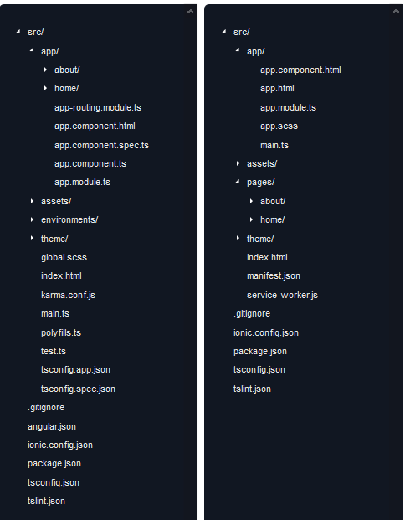
Ionic 4 Ionic 3

Slide 20
RxJS Changes
Between V3 and V4, RxJS was updated to version 6. This changes many of the import paths of operators and core RxJS functions. Please see the RxJS Migration Guide for details.

Slide 21
Lifecycle Events
With V4, we're now able to utilize the typical events provided by Angular. But for certain cases, you might want to have access to the events fired when a component has finished animating during its route change. In this case, the ionViewWillEnter, ionViewDidEnter, ionViewWillLeave, and ionViewDidLeave have been ported over from V3. Use these events to coordinate actions with Ionic's own animations system.
Older events like ionViewDidLoad, ionViewCanLeave, and ionViewCanEnter have been removed, and the proper Angular alternatives should be used.
For more details, check out the router-outlet docs

Slide 22
Overlay Components
In prior versions of Ionic, overlay components such as Loading, Toast, or Alert were created synchronously. In Ionic v4, these components are all created asynchronously. As a result of this, the API is now promise-based.
// v3
showAlert() {
const alert = this.alertCtrl.create({
message: "Hello There",
subHeader: "I'm a subheader"
});
alert.present();
}

Slide 23
In v4, promises are used:
showAlert() {
this.alertCtrl.create({
message: "Hello There",
subHeader: "I'm a subheader"
}).then(alert => alert.present());
}
// Or using async/await
async showAlert() {
const alert = await this.alertCtrl.create({
message: "Hello There",
subHeader: "I'm a subheader"
});
await alert.present();
}

Slide 24
Navigation
In V4, navigation received the most changes. Now, instead of using Ionic's own NavController, we integrate with the official Angular Router. This not only provides a consistent routing experience across apps, but is much more dependable. The Angular team has an excellent guide on their docs site that covers the Router in great detail.
To provide the platform-specific animations that users are used to, we have created ion-router-outlet for Angular Apps. This behaves in a similar manner to Angular's router-outlet but provides a stack-based navigation (tabs) and animations.
For a detailed explanation in navigation works in a V4 project, check out the Angular navigation guide.

Slide 25
Lazy Loading
Since Navigation has changed, the mechanism for lazy loading has also changed in V4.
In v3, a typical lazy loading setup worked like this:
// home.page.ts
@IonicPage({
segment: 'home'
})
@Component({ ... })
export class HomePage {}
// home.module.ts
@NgModule({
declarations: [HomePage],
imports: [IonicPageModule.forChild(HomePage)]
})
export class HomePageModule {}

Slide 26
However, in v4, lazy loading is done via the loadChildren method of the Angular router:
// home.module.ts
@NgModule({
imports: [
IonicModule,
RouterModule.forChild([{ path: '', component: HomePage }])
],
declarations: [HomePage]
})
export class HomePageModule {}
// app.module.ts
@NgModule({
declarations: [AppComponent],
imports: [
BrowserModule,
IonicModule.forRoot(),
RouterModule.forRoot([
{ path: 'home', loadChildren: './pages/home/home.module#HomePageModule' },
{ path: '', redirectTo: 'home', pathMatch: 'full' }
])
],
bootstrap: [AppComponent]
})
export class AppModule {}

Slide 27
Question???

